Slide 1
CS 310 Operating Systems Lecture 2: Operating System Concepts – Part 1 Process and Address Space - Introduction
Ravi Mittal
IIT Goa

Slide 2
Acknowledgements !
Contents of this class presentation have been taken from various sources. Thanks are due to the original content creators:
Class presentation: University of California, Berkeley: David Culler, Anthony D. Joseph, John Kubiatowicz, AJ Shankar, George Necula, Alex Aiken, Eric Brewer, Ras Bodik, Ion Stoica, Doug Tygar, and David Wagner.
Book: Operating Systems: Principles and Practice (2nd Edition) Anderson and Dahlin, Volume 1

Slide 3
Read the following:
Operating Systems: Principles and Practice (2nd Edition) Anderson and Dahlin
Volume 1, Kernel and Processes
Chapter 2

Slide 4
We will study..
Introduction
The first concept: Processes
The Second Concept: Address Space
The Third Concept: Threads
The Fourth Concept: Dual Mode of Operation

Slide 5
Last Class

Slide 6
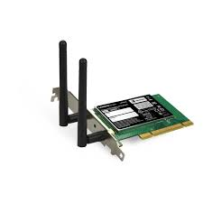
Recall: OS Protection
Compiled
Program 1
Compiled
Program 2
System Libs
System Libs
Compiler
Process 1
Process 2
Threads
Address Spaces
Files
Sockets
Threads
Address Spaces
Files
Sockets
Operating System
ISA
Processor
PgTbl
& TLB
Memory
Storage
Networks
Hardware
OS
Mem
I/O Ctrlr

Slide 7
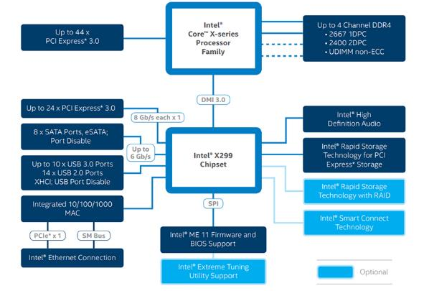
Recall: HW Functionality ⇒ great complexity!
Memory Channels
(High BW DRAM)
Really High Speed I/O (e.g. graphics)
Direct Media Interface (3.93 GBytes/sec)
High-Speed I/O devices (PCI Exp)
HD Audio
Disks (8 x SATA)
PCI/e Drives
Slower I/O (USB)
RAID 0/1/5/10
Integrated Ethernet
Smart Connect (autoupdate)
Intel Skylake-X I/O Configuration

Slide 8
Recall: Increasing Software Complexity
New Versions usually (much) larger older versions!
Cars getting really complex!
Millions of Lines of Code
(source https://informationisbeautiful.net/visualizations/million-lines-of-code/)
Linux 5.3 has approx. 27 million lines of code

Slide 9
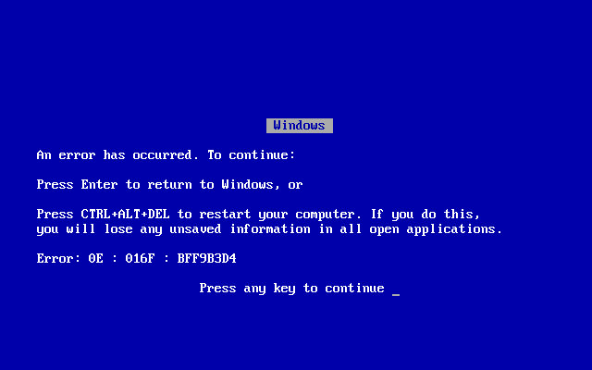
Complexity leaks into OS if not properly designed
Buggy device drivers
Holes in security model or bugs in OS lead to instability and privacy breaches
Meltdown (2017)
Spectre (2017)

Slide 10
OS Abstracts Underlying Hardware to help Tame Complexity
Processor → Thread
Memory → Address Space
Disks, SSDs, … → Files
Networks → Sockets
Machines → Processes
Application
Operating System
Hardware
Abstract Machine Interface
Physical Machine Interface

Slide 11
Design Goals of an Operating System
Abstraction of the hardware resources
Convenience of users
Efficiency of usage of CPU, Memory etc
Isolation between multiple processes

Slide 12
Four important concepts..

Slide 13
Four Fundamental OS Concepts
Process: an instance of a running program
Protected Address Space + One or more Threads
Address space
Set of memory addresses accessible to program (for read or write)
Thread: Execution Context
Fully describes program state
Dual mode operation / Protection
User / Kernel mode

Slide 14

OS Bottom Line: Run Programs
0xFFF…
Executable
Program Source
OS
int main()
{ … ;
}
compiler
data
Load & Execute
stack
editor
Memory
instructions
heap
a.out
ELF
data
foo.c
Load instruction and data segments of executable file into memory
OS creates the process
Create stack and heap
“Transfer control to program”
Provide services to program
While protecting OS and program
instructions
0x000…
PC:
registers
Processor
ELF: Executable and Linking Format

Slide 15
Operating System Needs are changing (1)
Network Speeds:
1980: 300 bps /$
2000: ~ 256 Kbps /$
2020: ~ 20 Mbps/$
So, in the past 40 years, the speed of networking has increased by a factor of ~ 67000 times
We now have Internet connection of 1 Gbps

Slide 16
Operating System Needs are changing (2)
Number of Cores / CPU
1980: 1 core / CPU
2000: 1 core / CPU
2020: 8+ cores / CPU → 64 cores / Server-CPU
So, in the past 20 years, the number of cores have become 10 times or more
How OS handles tasks on so many cores?
Process/job management
Power Management
Scheduling, Availability, Security

Slide 17
Operating System Needs are changing (3)
Cost per megaflop/sec:
1980: ~ $100,000 /megaflop/sec
2000: ~ $25 /megaflop/sec
2020: ~ $0.20 /megaflop/sec
So, in the past 40 years, the cost of per million operations has decreased by a factor of ~ 500,000 times

Slide 18
Operating System Needs are changing (4)
RAM Capacity B/$:
1980: ~ 2 KiB /$
2000: ~ 2 MiB /$
2020: ~ 2 GiB /$
So, in the past 40 years, the cost per byte of RAM has decreased by a factor of ~ 1,000,000 times

Slide 19
Operating System Needs are changing (5)
Ratio of Computers to Users
1980: ~ 100 users : 1 computer
2000: ~ 1 user : 1 computer
2020: ~ 1 user : many computers
So, in the past 40 years, the number of users to computer ratio has increased by a factor of at least 200 times
Paradigm shift in which OS are designed for evolving computing technology

Slide 20
Operating System Challenges
Reliability
Availability
Security
Privacy
Portability
Performance

Slide 21
OS System needs are changing
Legacy Needs
Modern Needs
Future Needs
Runs one application at a time
Manage time quotas for many users
Uses submit jobs and get results days later
Multiprogramming across many cores and many concurrent users
Interactive jobs; completing all jobs asap
Optimize for users not for computer’s resource time
Manage and use an ever-increasing number of processors/computers
Peta-scale storage, data centers, cloud
Optimize for diversity

Slide 22
The first OS concepts - Process

Slide 23
What is a process ?
A process is a program in execution
The process is the OS’s abstraction for execution
Execution environment with restricted rights
(Protected) Address Space with One or More Threads
Owns memory (address space), file descriptors, sockets
Encapsulate one or more threads sharing process resources
Simplest (classic) case: a sequential process
A single thread of execution (an abstraction of the CPU)
A sequential process is
The unit of execution
The unit of scheduling
The dynamic (active) execution context
vs. the program – static, just a bunch of bytes

Slide 24
Process – Two key abstractions
Process is not the binary source code
It is an instance of running program
Process provides two key abstractions
Memory
Each process assumes entire system memory to itself
Execution
Provides abstraction of continued operation
There may be hundreds of processes in a system
Each process gets impression of continuous operation

Slide 25
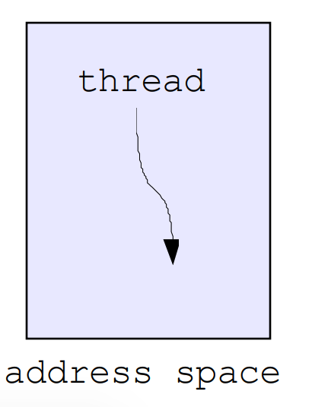
What is a Process?
Why processes?
Protected from each other! OS Protected from them
Processes provides memory protection

Slide 26
Protection and Isolation
Processes provide protection and isolation
Reliability: bugs can only overwrite memory of process they are in
Security and privacy: malicious or compromised process can’t read or write other process’ data
Mechanisms:
Address translation: address space only contains its own data

Slide 27
The Second OS concepts – Address Space

Slide 28
Second OS Concept: Address Space
Address space ⇒ the set of accessible addresses + state associated with them:
For 32-bit processor: 2³² = 4 billion (10⁹) addresses
For 64-bit processor: 2⁶⁴ = 18 quintillion (10¹⁸) addresses
The address space of a process contains all of the memory state of the running program
What happens when you read or write to an address?
Perhaps acts like regular memory
Perhaps causes I/O operation
(Memory-mapped I/O)
Perhaps causes exception (fault)
Communicates with another program
0xFFF…
stack
heap
Static Data
code
0x000…

Slide 29
Address Space: In a Picture
0xFFF…
PC:
stack
SP:
heap
Processor
registers
Static Data
instruction
Code Segment
0x000…

Slide 30
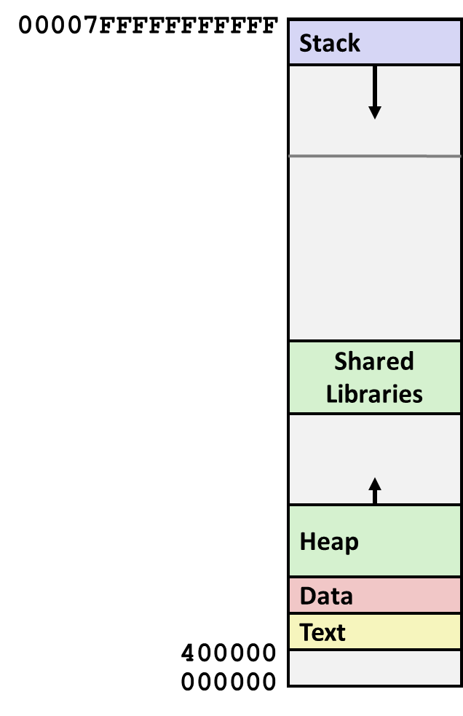
Recall: Each process can have the same address space
Process 1
Process 2
Process n
Solution: Virtual Memory

Slide 31
Address Space

Slide 32
Linux Memory layout of a process
Unix: Kernel space is mapped in high - but inaccessible to user processes

Slide 33
Address Space Translation
Program operates in an address space that is distinct from the physical memory space of the machine
“virtual address”
“physical address”
0x000…
Processor
translator
Memory
Registers
0xFFF…

Slide 34
Translation through Page Table
Code
Data
Heap
Stack
Data 2
Code
Data
Heap
Stack
Stack 1
Heap 1
Code 1
Stack 2
Prog 1
Virtual
Address
Space 1
Prog 2
Virtual
Address
Space 2
Data 1
Heap 2
Code 2
OS code
Translation Map 1
OS data
Translation Map 2
OS heap &
Stacks
Physical Address Space

Slide 35
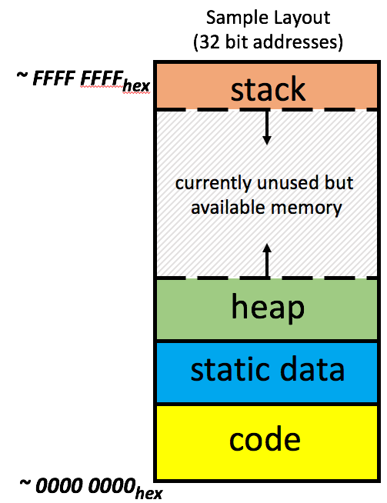
Recall: Processors operate in Virtual Address Space
Memory manager
Processor (& Caches)
?
Memory (DRAM)
Control
Datapath
Virtual Address
PC
Physical Address
Bytes
Registers
(ALU)
Many of these (software & hardware cores)
One main memory
Each Process uses it’s own address space
Processes use virtual addresses
Many processes, all using same (conflicting) addresses
Memory uses physical addresses (also, e.g., 0 ... 0xffff,ffff)
Memory manager maps virtual to physical addresses

Slide 36
Lecture Summary
The four important concepts of Operating Systems include
Process
Address Space
Thread
Dual mode of operation / Protection
Process is a program in execution
To create a process, the OS does the following
Creates space in MM to hold
Code (Text), Stack, Heap, and Static
Starts running a process by executing the first instruction pointed by the PC
Address space ⇒ the set of accessible addresses + state associated with them

